Slide 1
Problem Solving (Number Theory)
Srivaths P

Slide 2
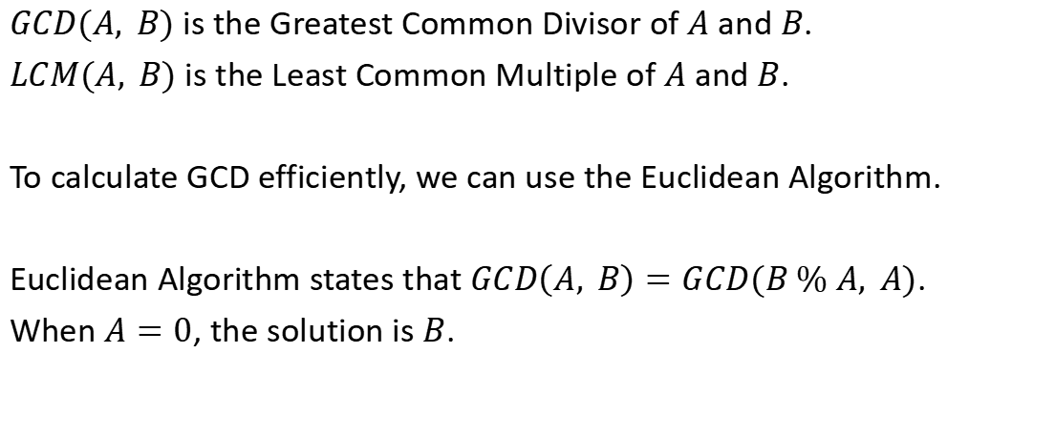
Greatest Common Divisor
$GCD(A, B)$ is the Greatest Common Divisor of $A$ and $B$.
$LCM(A, B)$ is the Least Common Multiple of $A$ and $B$.
To calculate GCD efficiently, we can use the Euclidean Algorithm.
Euclidean Algorithm states that $GCD\left(A, B\right)=GCD(B \% A, A)$.
When $A=0$, the solution is $B$.

Slide 3
Euclidean Algorithm – Code
Recursive:
Iterative:
int gcd_(int a, int b) { if (a == 0) return b; return gcd_(b%a, a); }
int gcd_(int a, int b) { while (a) { int t = a; a = b % a; b = t; }
return b; }

Slide 4

Least Common Multiple
$LCM\left(A,B\right)$ can be calculated as
$$\frac{A×B}{GCD(A,B)}$$

Slide 5
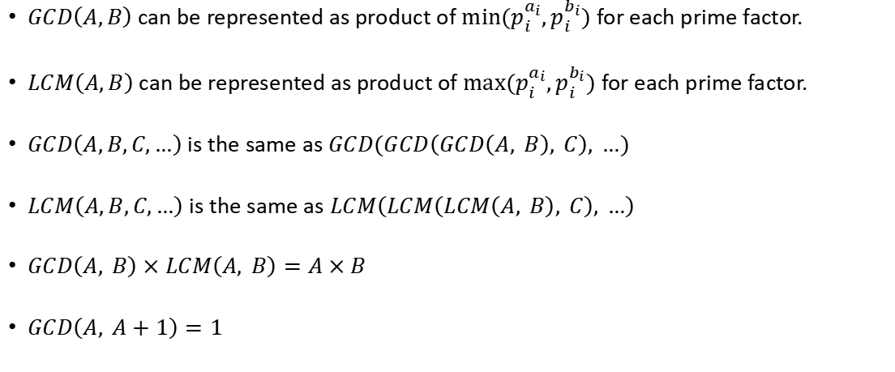
Properties of GCD / LCM
$GCD\left(A,B\right)$ can be represented as product of $min⁡(p_{i}^{a_{i}},p_{i}^{b_{i}})$ for each prime factor.
$LCM\left(A,B\right)$ can be represented as product of $max⁡(p_{i}^{a_{i}},p_{i}^{b_{i}})$ for each prime factor.
$GCD\left(A,B,C,…\right)$ is the same as $GCD(GCD\left(GCD\left(A, B\right), C\right), …)$
$LCM\left(A,B,C,…\right)$ is the same as $LCM\left(LCM\left(LCM\left(A, B\right), C\right), …\right)$
$GCD\left(A, B\right)×LCM\left(A, B\right)=A×B$
$GCD\left(A, A+1\right)=1$

Slide 6
OEIS - Online Encyclopedia of Integer Sequences
Link: https://oeis.org/
OEIS can be used to find the formula of an integer sequence with just the first few values (which could be computed using brute-force or manually by hand).

Slide 7
Problem Solving
https://cses.fi/problemset/task/1712
https://cses.fi/problemset/task/1081
https://codeforces.com/problemset/problem/1474/B
https://codeforces.com/problemset/problem/1471/A
https://codeforces.com/problemset/problem/1617/B

Slide 8
Thanks for Watching!
Feedback form: https://docs.google.com/forms/d/e/1FAIpQLSdgV2lscu_LaXe1-mobccTZ4ooeVkIsa6G08hqf-tEfLUx1CA/viewform

